Slide 1
Splunk (in) Cloud - Moving from OnPrem to AWS with SmartStore

Slide 2

Hello!
Steven Bochniewicz
@Stboch on Splunk Usergroup Slack

Slide 3
The Before!
14 indexers spread across two data centers
70TB Shared Storage in Each Data Center
2 Search Heads
3 TB per day Average ingestion

Slide 4
The Problem
500GB per year growth
~ 2 Indexers growth per year
Existing Hardware 3 Years Old
18 Months until EoL for Shared Storage

Slide 5
Options
SplunkCloud
Complex Multi-Tentant configuration not suitable for SplunkCloud
Expand Existing OnPrem
Postpones hardware changes to FY24 but still limits capacity
Move to AWS
Already have dual 10GB AWS Direct Connects and Splunk SmartStore is designed on S3

Slide 6
Move to AWS
Current Indexes use about 10TB of physical disk
Migration to SmartStore and S3 will allow for near unlimited retention on an index level
Scable Design of AWS allows deployment of systems sized for the migration
Easily add and remove capacity as needed

Slide 7
The Plan!
On Prem: Indexers
12 Core
96GB RAM
6TB Hot 4TB Cold
X 14
AWS: Migration State
I3en.3xlarge
12 vCPU
96GB RAM
7.5TB Instance Storage
x15

Slide 8
Migrate Existing Cluster
Build new Cluster Master
Copy existing Cluster Master Configuration
Verify New Cluster Master ready to migrate
Shutdown Old Cluster Master
Change existing CName to new Server
Verify Indexers have joined to Cluster Master
Verify Cluster Bundle has correct information

Slide 9
Cluster Manager Migration sTEPS (Appendix?)
On the OLD Cluster Manager
Verify if your using master-apps or manager-apps and adjust accordingly
# scp -r /opt/splunk/etc/master-apps/ splunk@<newClusterManager>:/opt/splunk/etc/
# scp -r /opt/splunk/etc/system/local/server.conf splunk@<newClusterManager>:/opt/splunk/etc/system/local/
# /opt/splunk/bin/splunk stop
# scp -r /opt/splunk/var/run/splunk/cluster/remote-bundle splunk@<newClusterManager>:/opt/splunk/var/run/splunk/cluster/remote-bundle
On the New Cluster Manager
# vi /opt/splunk/etc/system/local/server.conf
Edit the following with the correct pass4SymmKey and sslPassword if you do not know it see link for instructions
[clustering]
pass4SymmKey=
[general]
sslPassword=
# /opt/splunk/bin/splunk start

Slide 10
Migration Increased Capacity
10TB > 7TB
Added 3 Additional indexers to increase capacity
Prior to peak activity

Slide 11
Indexers With Ephemeral Disk
Plan for no disk!
When an instance is “Stopped” the Data is lost
When AWS needs to “Restart” your instance the data is lost
Notes:
Using the i series indexers and taking advantage of Instance Storage for Splunk has some risks. Fast Cheap Storage but risky.

Slide 12
Ephemeral Fixes
Bootscript to ensure the volume is formatted and mounted properly
Ensure Splunk service requires the mount
In the systemd splunk service unit file ensure the mount used is set to requires, this will ensure Splunk will not start without the mount
[Unit]
After=network.target splunk.mount
Requires=splunk.mount

Slide 13
Mounting Caveats
Ensure that nofail,x-systemd.device-timeout=2
is in the fstab otherwise system will fail on a restart when the volume is missing
After you mount the volume you need to chown the folder to Splunk(or what ever user you run splunk as)
Since the default owner will be root

Slide 14
New Indexers YAY!
Test Splunk can write
Restart ensure everything returns
Stop/Start instance to ensure all the bootscripts are working
Tested? Time to Add
Ensure your indexers are in the correct Site #
The sites should align with your AZ zones.
Do not span Sites across an AZ

Slide 15
Decommission - Old Indexers
Migrate clients to new indexers
Ensure all clients are sending to new servers by using a realtime search and splunk_server=(old indexer names)
Place all Old Indexers into manual detention
# splunk edit cluster-config -auth <username>:<password> -peers <peer_guid1>,<peer_guid2>,... -manual_detention on
If you chose to use new sites # and retire the old sites you will need to follow this https://docs.splunk.com/Documentation/Splunk/9.0.1/Indexer/Decommissionasite
Otherwise stop indexers by site
# splunk offline –-enforce-counts
Once all indexers have been shut down, verify cluster master replication and search factor are met. Restart Cluster Master.

Slide 16
In AWS so now what?
After migration of to AWS now time to for SmartStore
SmartStore is a one-way street
SmartStore will leverage AWS S3
Can dramatically reduce overage storage

Slide 17
When not to use SmartStore for an Index
Indexes that are frequently searched over long periods of time
Indexes that require Data integrity control feature

Slide 18
Configuration SmartStore
Create S3 Bucket
Ensure this is the same region your AWS indexers are located
Ensure block all public access
Enable Request metrics - (this comes with an increase cost but will help troubleshooting)
Create IAM Role for Indexers (See Appendix for Role)
Assign to EC2 Instance

Slide 19
SmartStore Limitations
Limit size - MaxDataSize should be Auto (splunk recommendation) We implemented 1024
SmartStore does not support Thawed buckets you will need to restore these buckets into an alternate index.
Buckets that were moved into Cold Path prior to SmartStore will be cached in this same path
For multisite clusters, SmartStore indexes use report acceleration or data model acceleration, you must disable search affinity by setting all search heads to site0
Ensure these aren’t set on indexes
enableTsidxReduction = true
createBloomfilter = false
enableOnlineBucketRepair = false
Remove from volumes
maxVolumeDataSizeMB
This will remove nuisance errors

Slide 20
Create the Volume Definition And Test Index
Indexes.conf
[volume:s3]
storageType = remote
path = s3://(folder for base in bucket)
remote.s3.endpoint = https://(bucketURL)
Pick index to test conversion
remotePath = volume:s3/$_index_name

Slide 21
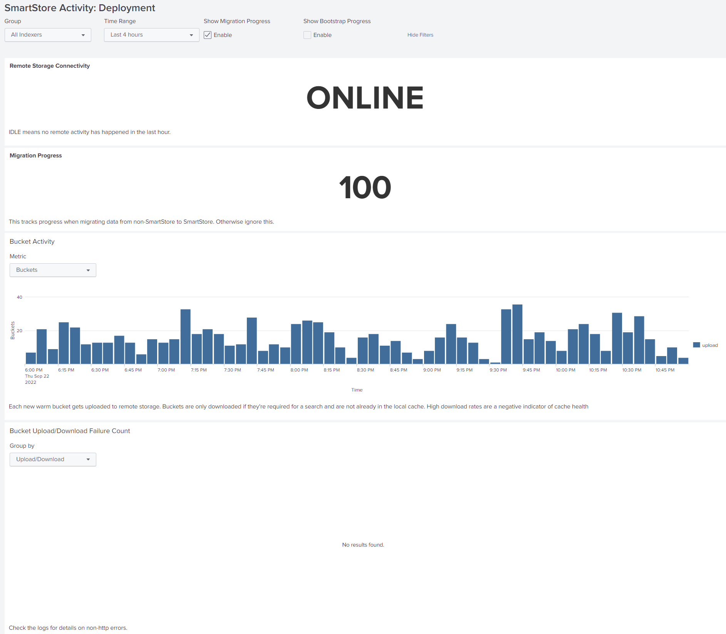
Push the configs!
This will require a rolling restart of your cluster.
Once complete verify objects are present in your bucket
You can also check Monitoring Console

Slide 22
Finish Migration of All Indexes
Once you have successfully migrated a test index
Time to finish
Add RemotePath = to all indexes individually
Adding to [default] will automatically make all indexes SmartStore (don’t use this method if you plan to have indexes not-smartstore or need Thaw Indexes)
Ensure the Cluster Master Search and Replication factor match, doing this after the migration will prevent the need for a increase in rebuilt searches

Slide 23
Smart Store savings!

Slide 24
SmartSTore Migration Results
About 64TB in each data center, for 128 TB used in both data centers.
S3 Post migration only used 68TB
Almost 50% reduction
Has since grow to 78TB due to the start of our semester
Currently we have a less than 2% Cache Miss rate
due to existing cluster sized same storage as required for full retention

Slide 25
Shutting Down AWS SmartStore Indexers
Decommissioning Excess Servers used during migration
On planned decommissioned indexers # splunk edit cluster-config -auth <username>:<password>.. -manual_detention on
# splunk restart
(this restart is required to force hot buckets to roll and send to SmartStore)
# splunk offline —-enforce-counts
Once servers have been decommissioned and the replication and search factors are met restart cluster master for the cluster master to forget about these indexers.

Slide 26
AWS S3 LifeCycle - Storage Tier
Default Standard Tier
Fastest Service, tiered pricing based on storage.
Our usage around $.022/gb
Planned Intelligent Tiering
Everything other then 30 days starts to save us storage costs, %50 reduction, after 90 days of further reduction of 65%
(Still awaiting results as we are only 30 days in)

Slide 27
Documentation has cool features and pitfalls
remote.s3.header.PUT.x-amz-storage-class = REDUCED_REDUNDANCY
This seems like it worked at first but alas it isn’t supported by AWS the way Splunk implemented it.
So it instead use S3 lifecycle policies to change storage class. This will give you better control in writing your policies and works.
I had big plans for the support for these headers and none of them worked in practice.

Slide 28


Slide 29
Search Window Sizing Appendix
(search_id!="rsa_*" action=search index=_audit sourcetype=audittrail)
| eval user=if((user == "n/a"),null(),user), search_type=case(match(search_id,"^SummaryDirector_"),"summarization",match(search_id,"^((rt_)?scheduler__|alertsmanager_)"),"scheduled",match(search_id,"\\d{10}\\.\\d+(_[0-9A-F]{8}-[0-9A-F]{4}-[0-9A-F]{4}-[0-9A-F]{4}-[0-9A-F]{12})?$"),"ad hoc",true(),"other"), search=if((isnull(savedsearch_name) OR (savedsearch_name == "")),search,savedsearch_name)
| stats min(_time) as _time, values(user) as user, first(search) as search, first(search_type) as search_type, first(apiStartTime) as apiStartTime, first(apiEndTime) as apiEndTime by search_id
| search user="*"
| fields + search, _time, apiStartTime, apiEndTime, search_type, user
| eval earliest=case((like(apiStartTime,"%ZERO_TIME%") AND like(apiEndTime,"%ZERO_TIME%")),"all time",like(apiStartTime,"%ZERO_TIME%"),"-",true(),apiStartTime), latest=case((like(apiStartTime,"%ZERO_TIME%") AND like(apiEndTime,"%ZERO_TIME%")),"all time",like(apiEndTime,"%ZERO_TIME%"),"-",true(),apiEndTime), search=if(isnotnull(search),search,"N/A"), _time=strftime('_time',"%m/%d/%Y %H:%M:%S %z")
| sort - total_run_time
| fields + search, _time, earliest, latest, search_type, user
| eval search_time=round(strptime(latest, "%a %b %d %H:%M:%S %Y") - strptime(earliest, "%a %b %d %H:%M:%S %Y"))
| stats avg(search_time) as avg_search_time max(search_time) as max_search_time count by user search_type
| eval avg_search_time=tostring(avg_search_time, "duration")
| eval max_search_time=tostring(max_search_time, "duration")
| rename max_search_time as "Max Search Time", avg_search_time as "Average Search Time", search_type as Type, user as User

Slide 30
S3 Role Appendix
{
"Version": "2012-10-17",
"Statement": [
{
"Action": [
"s3:PutObject",
"s3:GetObject",
"s3:DeleteObject",
"s3:ListBucketVersions",
"s3:DeleteObjectVersion",
"s3:PutObjectTagging",
"s3:GetObjectVersion"
],
"Resource": [
"arn:aws:s3:::splunk-smartsotre/*"
],
"Effect": "Allow",
"Sid": "ObjectLevel"
},
{
"Action": [
"s3:ListBucket"
],
"Resource": [
"arn:aws:s3:::splunk-smartstore"
],
"Effect": "Allow",
"Sid": "BucketLevel"
}
]
}

